Slide 1
Capstone: Opening an Ethical Lebanese Restaurant in New York
IBM Applied Data Science Capstone - Professional Certificate

Slide 2
Introduction:
New York City’s demographics show that it is a large and ethnically diverse metropolis. It is the largest city in the United States with a long history of international immigrants. New York city was home to nearly 8.399 million people in 2018, accounting for over 40% of population of New York State and a slightly lower percentage of the New York metropolitan area, home to approximately 23.6 million. Over the last decade, the city has been growing faster than the other region. The New York continues to be by far the leading metropolitan gateway for legal immigrants admitted into the United States. This final project explores the best locations for Lebanese restaurants throughout the city of New York. Potentially the owner of new Lebanese restaurant can have great success and consistent profit. However, as with any business, opening a new restaurant requires serious considerations and is more complicated than it seems from the first glance. In particular, the location of the restaurant is one of the most important factors that will affect whether it will have success or failure. So, our project will attempt to answer the questions “Where should the investor open a Lebanese Restaurant?” and “Where should I go if I want great Lebanese food?”

Slide 3

Business Problem:
The objective of this Capstone project is to analyse and select the best locations in the city of New York to open a new Lebanese restaurant. Using Data Science methodology and instruments such as Data Analysis and Visualization, this project aims to provide solutions to answer the business question: Where in the city of New York, should the investor open a Lebanese Restaurant?
This Photo by Unknown Author is licensed under CC BY-ND

Slide 4
DATA:
Data Required
List of borough and neighborhoods of New York
Latitude and longitude coordinates of those neighborhoods
Venue data, particularly data related to restaurants
sources:
Data Required
Open-source dataset of New York: https://cocl.us/new_york_dataset
Geocoder package for latitude and longitude coordinates
Foursquare API for venue data

Slide 5
methodology:
Collect the data from https://cocl.us/new_york_dataset . Clean and process the data into a dataframe.
Using FourSquare, locate all venues and then filter by Lebanese restaurants.
Sort the data based on rankings
Visually assess the data be will be using graphing from Python libraries

Slide 6
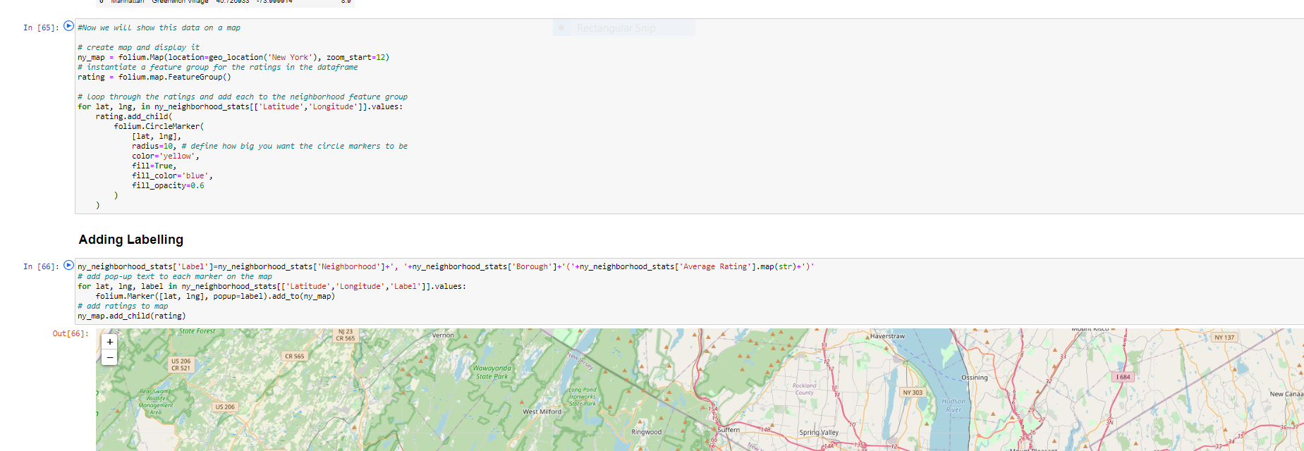

Slide 7
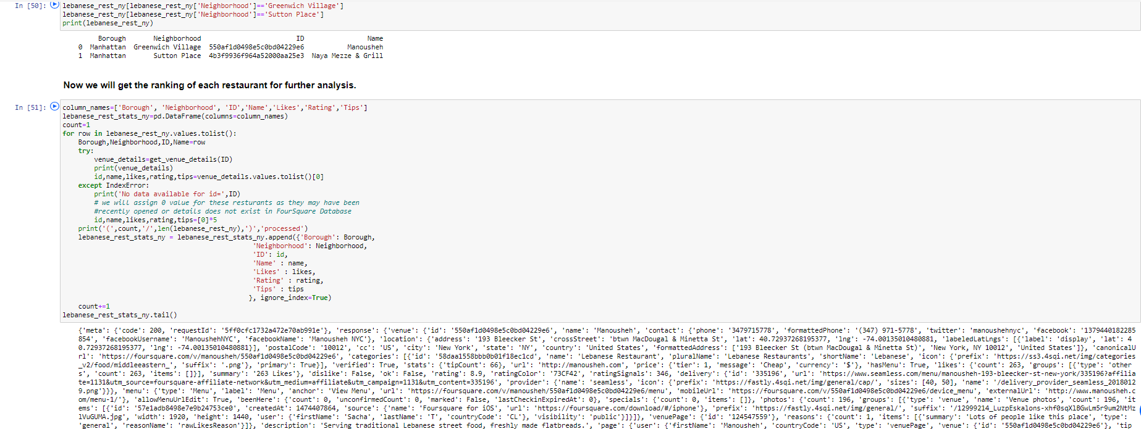
METHODOLOGY CNTD…

Slide 8
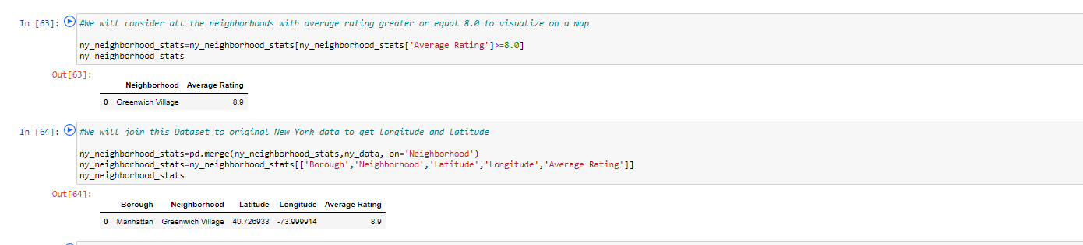
METHODOLOGY CNTD….

Slide 9
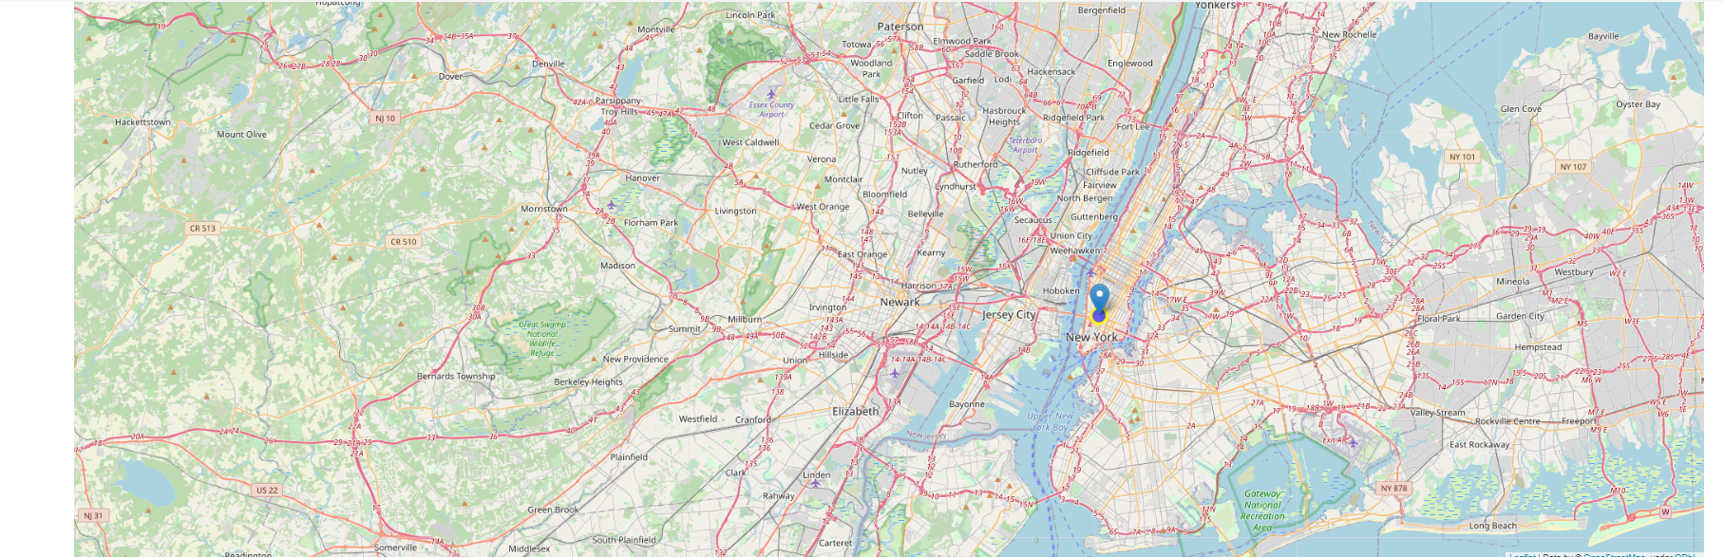
RESULTS
Manhattan has the best rated Lebanese restaurants on average. Staten Island and The Bronx have the least number of Lebanese restaurants per borough. However, of note, Greenwich Village and Sutton Place in Manhattan has the highest number of Lebanese Restaurants in all of NY. Despite Manhattan having the least number of neighborhoods in all boroughs, it has the greatest number of Lebanese restaurants. Based on the above information, I would state that Manhattan is the best locations for Lebanese cuisine in NYC. To have the best shot of success, I would open a Lebanese restaurant in and around Manhattan. Manhattan has multiple neighborhoods with average ratings exceeding 8.0 on a scale of 1.0 to 10.0 and has a smaller number of Lebanese restaurants than The Bronx, making competition easier. Also, we should keep in mind, that real estate prices in Manhattan are much cheaper than in Bronx. As a final note, all the above analysis is depended on the accuracy of Four-Square data. A more comprehensive analysis and future work would need to incorporate data from other external databases.

Slide 10
DISCUSSION SELECTION
Based on the results of our analysis, Manhattan is the best locations for Lebanese cuisine in NYC.
Manhattan is a more promising place to open a new Lebanese restaurant
Neighborhoods Sutton Plave is the best place in Manhattan to open a new Lebanese restaurant.

Slide 11
CONCLUSION
Answer to business question: Where in the city of New York, should the investor open a Lebanese Restaurant?
• Best rated Lebanese Restaurant in NYC the Restaurant in Manhattan.
• The findings of this project may be used in real life to better understand the advantages and disadvantages of different New York neighborhoods/boroughs in terms of opening a Lebanese restaurant.

Slide 12


